Slide 1
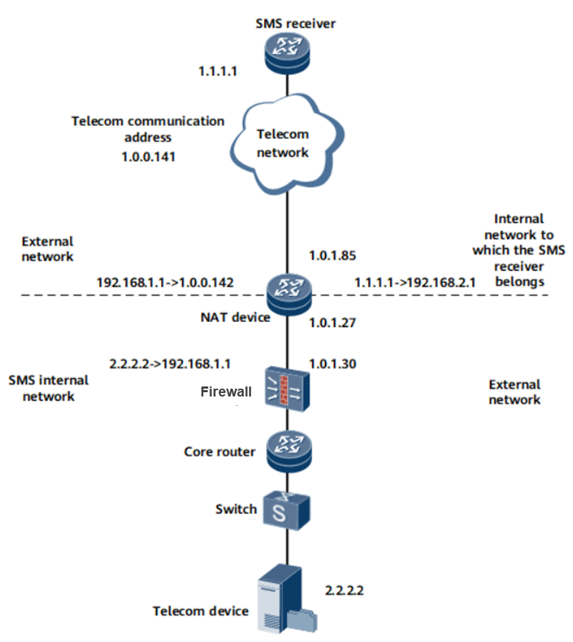
Leading Intelligent IP Networks
NetEngine 8000 with VSUP-100s installed has an enhanced capability of processing various CGN services, managing users based on logs, load-balancing NAT traffic, and enhancing user access security.
NetEngine 8000 CGN Solution
IPv4 over IPv6
Inter-chassis backup, inter-board backup, and centralized backup of distributed CGN devices
Application level gateway (ALG) for transparent translation for application layer protocols
Flexible and scalable
One or more VSUPs installed as needed flexibly on nodes
Flexible extension for a single NAT user
Secure access
Access to HQ everywhere while on a business trip
Limits on ports, sessions and user number
NAT blacklist against attacks
IPsec VPN tunnels established
User experience and loyalty improved
Port Control Protocol (PCP) deployed, with no changes in IPv4-to-IPv6 transition infrastructure
P2P connections for teleconference, online games, and P2P data transfer
32M IPv4 NAT sessions, 50Gbps@512B, 220K sessions/s
Copyright © Huawei Technologies Co., Ltd. 2022. All rights reserved.

Slide 2
Product Overview
NetEngine 8000 M6 is an all-scenario converged bearer router for the cloud era. It's featured with 2U height, 220 mm depth, supports up to 160G port capacity and 6 service slots, flexibly adapts to different services, and supports 50GE/25GE/10GE/GE/FE/CPOS/E1 interfaces. The compact design saves precious space resource, greatly reduces CAPEX, and protects the existing investment. Wide-temperature design enables it to be deployed in all scenarios. It also supports features such as SRv6, EVPN, network slicing, and 1588v2 high-precision clock, which make it the best choice for multi-service convergence in the cloud era.
Application Scenarios
Converged transport
NetEngine 8000 M6
DC
Internet
DC/Campus egress
DC
NetEngine 8000 M6
DC
DC
DC GW
DC GW
DC
Product Specifications
Item | Description
IPv4 NAT sessions | 32M
IPv4 NAT forwarding capability | 50Gbps@512B
Session setup speed | 220K/s
IPv4 NAT sessions | 32M
Maximum board capability | 50 Gbps
Capacity density (G/U) | 80
Main control board | 2, 1:1
SFU | 2, 1:1
Line card | 6
Power module | 2, 1+1
Fan module | 2, 1+2
Subcards Supported
Type | Description
50GE | 1*50GE(QSFP28)optical PIC
25GE | 2*25GE(SFP28)/2*10GE(SFP+) optical PIC
10GE | 4*10GE/GE(SFP+) optical PIC
10GE | 2*10GE/GE(SFP+) optical PIC
GE | 8*GE/FE(RJ45) electrical PIC
Type | Description
GE/FE | 10*GE/FE optical PIC
GE/FE | 20*GE(CSFP)/10*GE(SFP) optical PIC
CPOS | 4*CPOS(STM-1) optical PIC
E1 | 32*E1 electrical PIC
E1 | 16*E1 electrical PIC
Copyright © Huawei Technologies Co., Ltd. 2022. All rights reserved.

