Slide 1
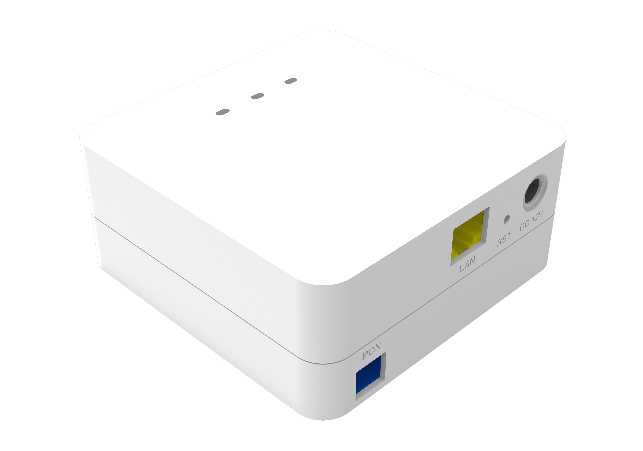
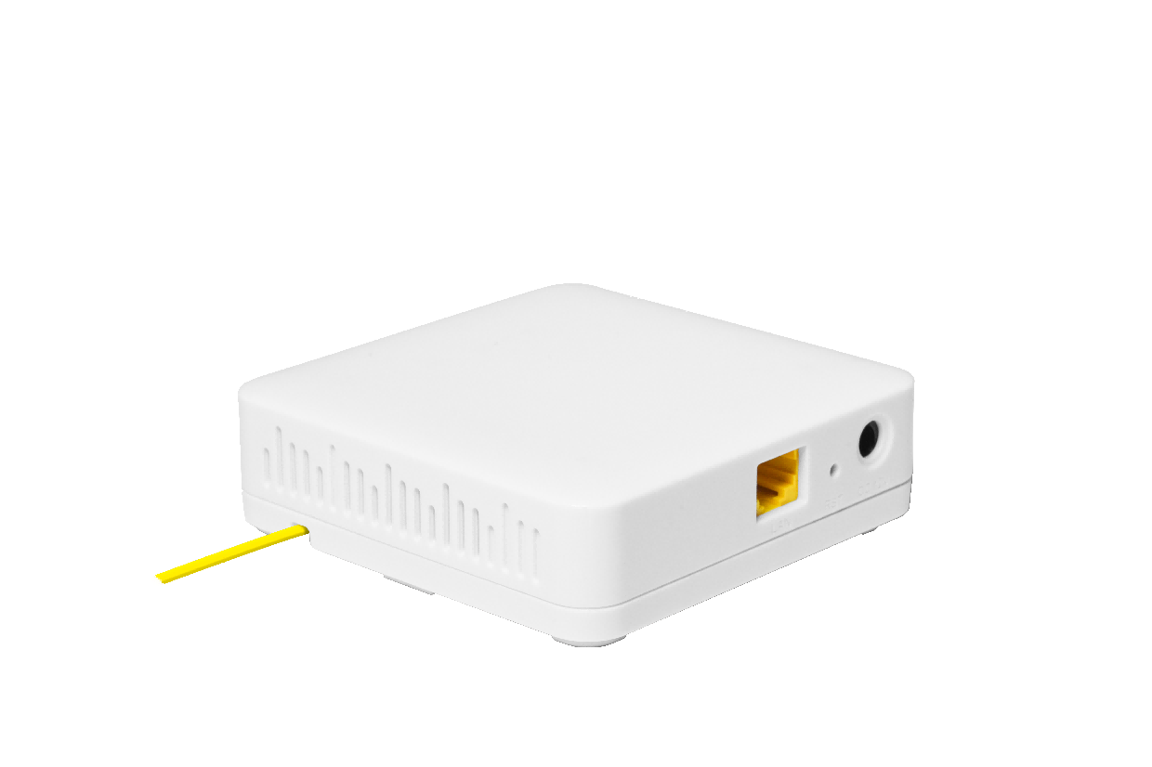

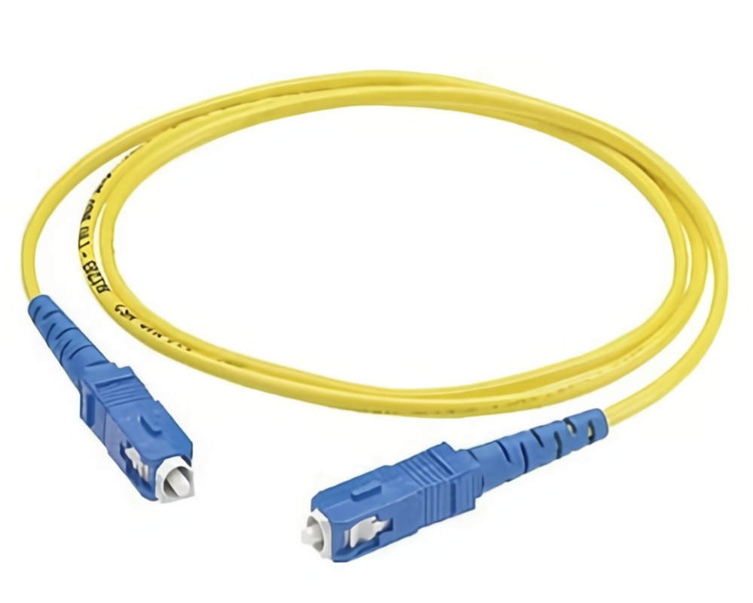







V2801SC
Wall mounted type
(With tray-mounted fiber structure)
Desktop type
(Without tray-mounted fiber structure)
1*XPON+1GE ONT witch Tray-mounted Fiber Structure
Key Features:
XPON Dual Mode
Automatically Access to EPON/GPON
Tray-mounted
Fiber Structure
Powerful Firewall
Wide Working Temp
-10℃～+55℃
Introduction:
V2801SC is a single gigabit port ONT with tray-mounted fiber structure is a new type of fiber terminal equipment. It features an optimized design, which enhances its transmission performance and reduces fiber loss due to its structure. It also supports single gigabit port access, catering to different access needs. With its exquisite craftsmanship and materials, the ONU appears elegant and stylish, providing stable communication services to home networks. This user-friendly ONU is an ideal choice for home broadband networks..
The ONT has high reliability and can be applied to a wide temperature environment; and has a powerful firewall function, which is easy to manage and maintain. It can provide QoS guarantee for different services. The ONT complies with international technical standards such as IEEE802.3ah and ITU-T G.984.
Application Chart:
12V DC
WiFi Device
Internet
IPTV
OLT
WiFi Router
PC
Splitter
V2801SC
VSOL product datasheet | Updated: 24 -11 - 2021 | Rev.2.0 | www.vsolcn.com

Slide 2
Hardware Parameter
Product Feature
Dimension | 91mm×91mm×41mm(L×W×H)
Net weight | 170g
Operating condition | Operating temp: -10 ~ +55°C Operating humidity: 10 ~ 90% (non-condensed)
Storing condition | Storing temp: -30 ~ +60°C Storing humidity: 10 ~ 90% (non-condensed)
Power adapter | DC 12V, 0.5A, external AC-DC power adaptor
Power supply | ≤4W
Interfaces | 1GE
Button | RST
Indicators | REG/LOS, LINK/ACT, SYS
Basic | Support MPCP discover&register Support authentication Mac/Loid/Mac+Loid Support Triple Churning Support DBA bandwidth Support auto-detecting, auto-configuration, and auto firmware upgrade Support SN/Psw/Loid/Loid+Psw authentication
Alarm | Support Dying Gasp Support Port Loop Detect Support Eth Port Los
LAN | Support Port rate limiting Support Loop detection Support Storm control
VLAN | Support VLAN tag mode Support VLAN transparent mode Support VLAN trunk mode(max 8 vlans)
Multicast | Support IGMPv1/v2/Snooping Max Multicast vlan 8 Max Multicast Group 64
QOS | Support 4 queues Support 802.1P
L3 | Support IPv4/IPv6 Support DHCP/PPPOE/Static IP Support Static route Support NAT
Management | Support CTC OAM 2.0 and 2.1 Support ITUT984.x OMCI Support WEB Support TELNET Support CLI
Interface Parameter
PON interface | 1 XPON port(EPON PX20+ & GPON Class B+) SC single mode, SC/UPC connector TX optical power: 0～+4dBm RX sensitivity: -27dBm Overload optical power: -3dBm(EPON) or -8dBm(GPON) Transmission distance: 20KM Wavelength: TX 1310nm, RX1490nm
LAN interface | 1*GE, Auto-negotiation RJ45 connectors
Function Data
XPON Mode | Dual mode,Auto-access to EPON/GPON OLT
Uplink Mode | Bridging and Routing Mode
Abnormal protection | Detecting Rogue ONU, Hardware Dying Gasp
Firewall | DDOS, Filtering Based on ACL/MAC/URL
Product Name | Product Description | Accessories
V2801SC | 1GE | AC-DC power adaptor: DC12V/0.5A

