Slide 1
How to Connect Cameras to the HOLOWITS Cloud Service and Use Basic Functions

Slide 2
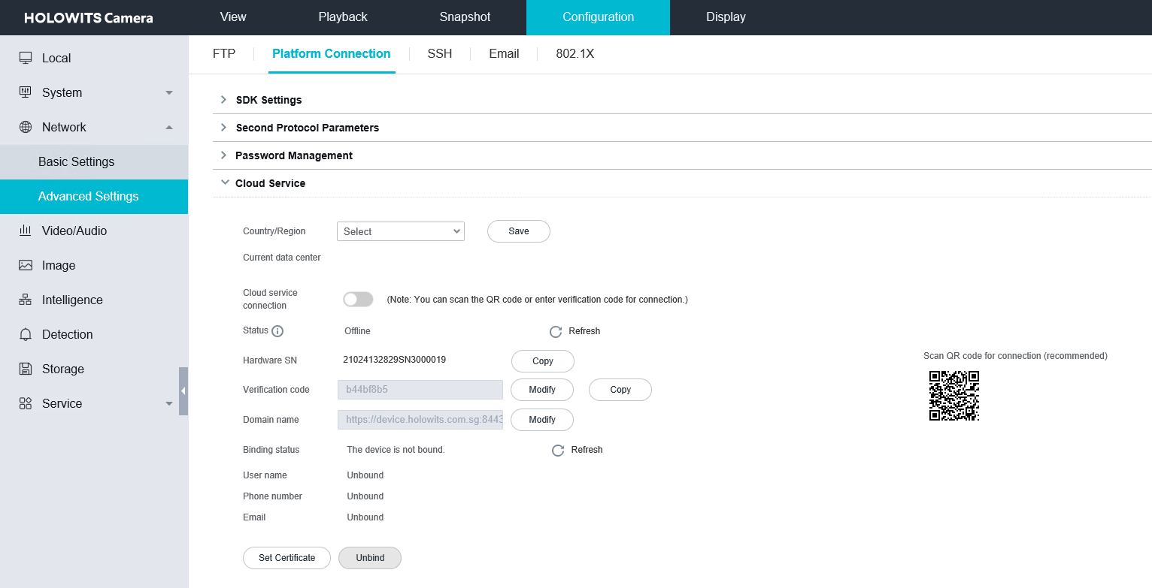
How to Connect to the HOLOWITS Cloud Service (1)
Access the cloud service connection page.
a. Configuration
b. Network
c. Advanced Settings
d. Platform Connection
e. Cloud Service

Slide 3
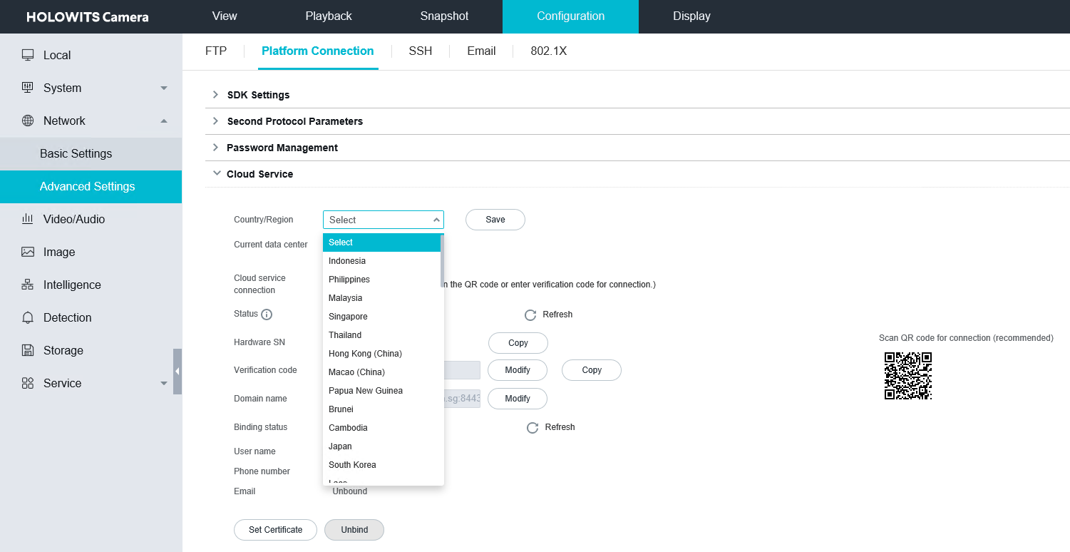
How to Connect to the HOLOWITS Cloud Service (2)
Enable cloud service connection.
Select a country or region and save the setting.
Enable cloud service connection.
Click OK in the Warning dialog box that is displayed.
Wait until the camera goes online.

Slide 4
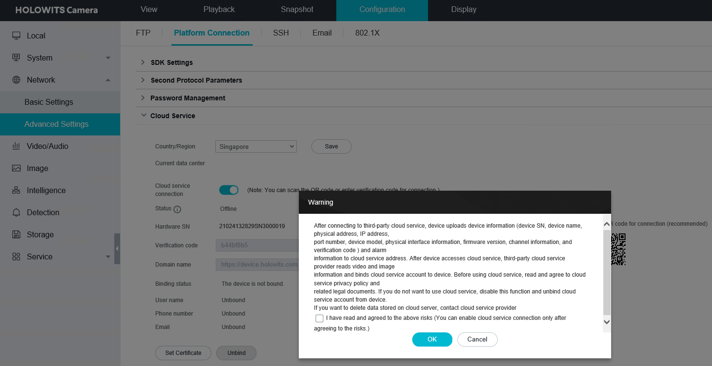
How to Connect to the HOLOWITS Cloud Service (3)
Enable cloud service connection.
Select a country or region and save the setting.
Enable cloud service connection.
Click OK in the Warning dialog box that is displayed.
Wait until the camera goes online.

Slide 5
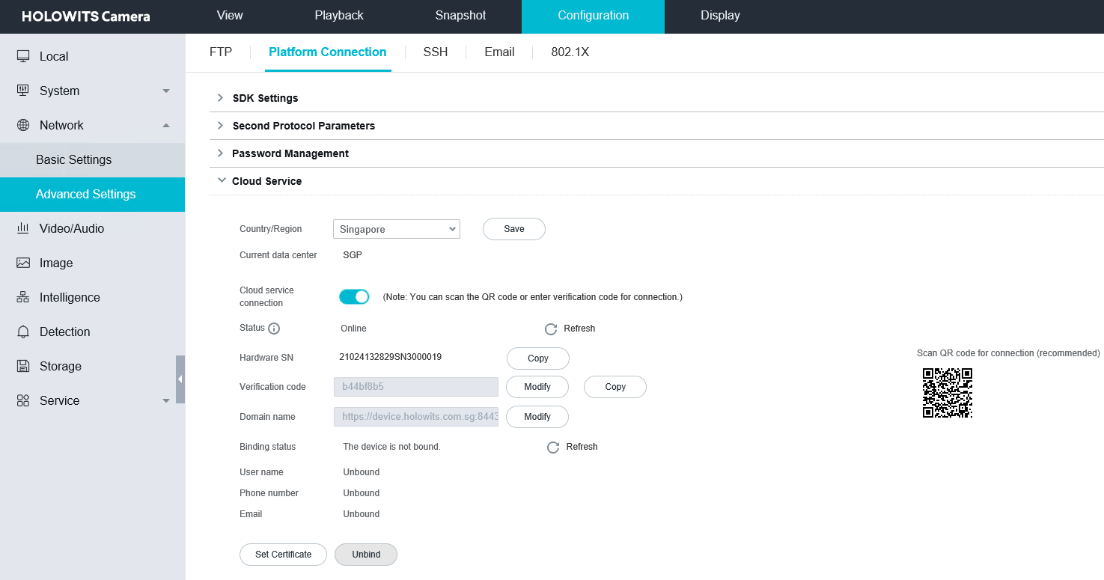
How to Connect to the HOLOWITS Cloud Service (4)
Enable cloud service connection.
Select a country or region and save the setting.
Enable cloud service connection.
Click OK in the Warning dialog box that is displayed.
Wait until the camera goes online.
Note: Before the camera goes online, the camera's hardware SN needs to be added to the trustlist of the HOLOWITS cloud service.

Slide 6
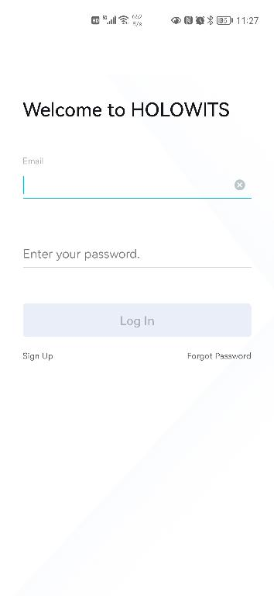
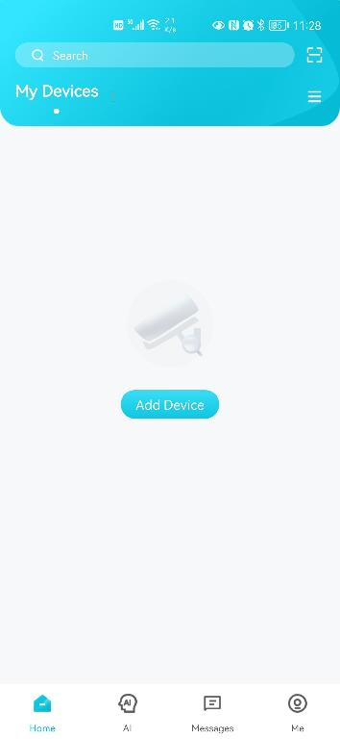
How to Connect to the HOLOWITS Cloud Service (5)
Download the HOLOWITS app and bind the required camera.
Search for HOLOWITS in Google Play / Apple Store and download the app.
Scan the QR code to bind the required camera.
Refresh the cloud service connection page to update binding information.

Slide 7
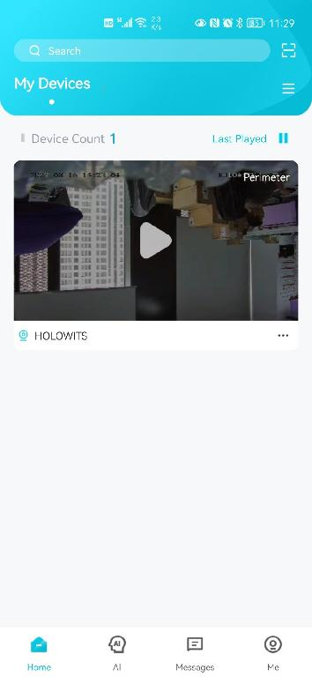
How to Connect to the HOLOWITS Cloud Service (6)
Download the HOLOWITS app and bind the required camera.
Search for HOLOWITS in Google Play / Apple Store and download the app.
Scan the QR code to bind the required camera.
Refresh the cloud service connection page to update binding information.

Slide 8
How to Connect to the HOLOWITS Cloud Service (7)
Download the HOLOWITS app and bind the required camera.
Search for HOLOWITS in Google Play / Apple Store and download the app.
Scan the QR code to bind the required camera.
Refresh the cloud service connection page to update binding information.

Slide 9
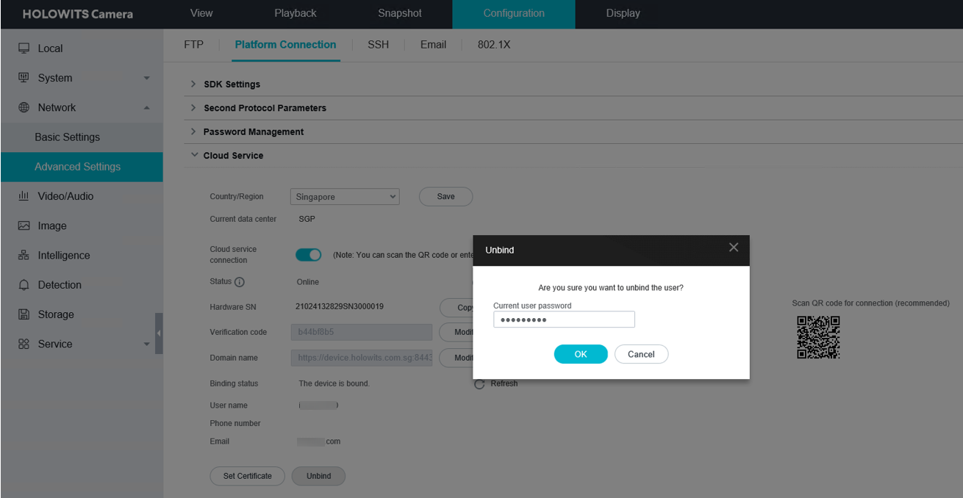
How to Use Basic Functions (1)
Unbind the required camera.
Access the cloud service connection page.
Click Unbind.
Enter the password for logging in to the camera web system.

Slide 10
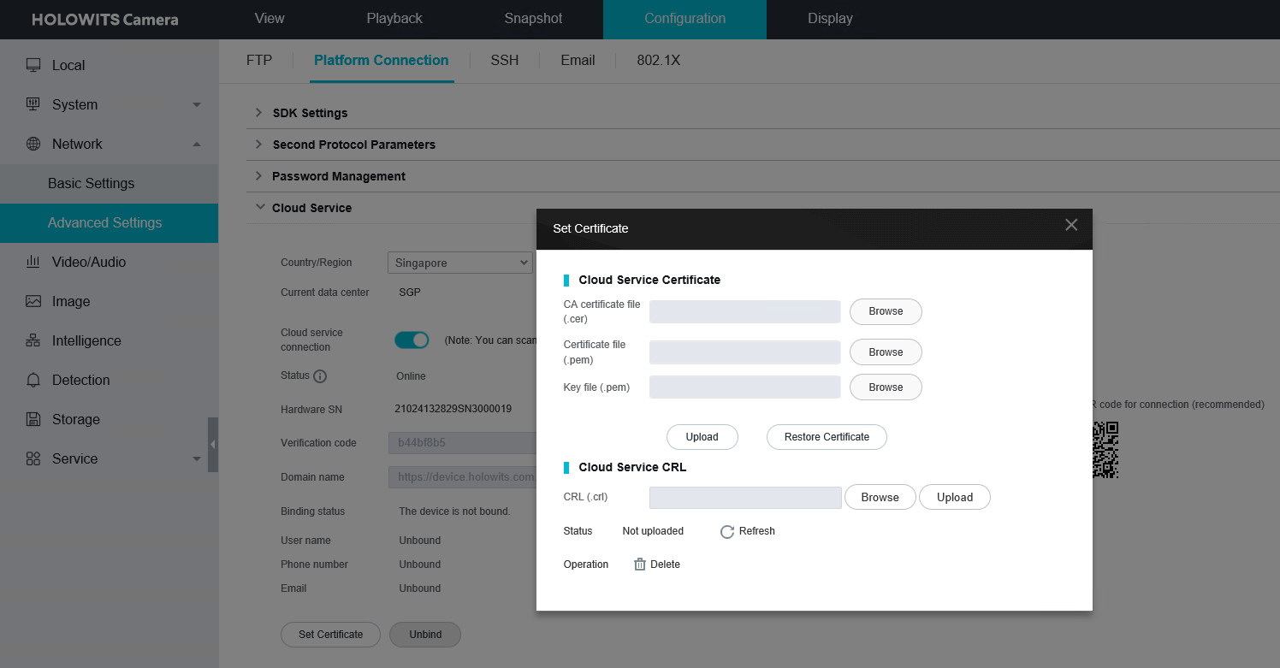
How to Use Basic Functions (2)
Restore to the default certificate.
Access the cloud service connection page.
Click Set Certificate.
Set required parameters and click Restore Certificate in the dialog box that is displayed.
Wait 10s to 20s for the camera to goes online again.

Slide 11
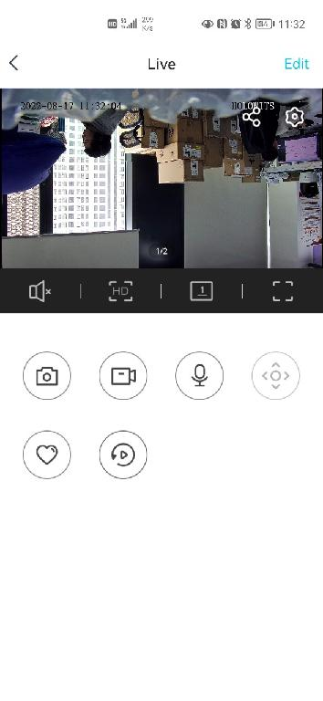
How to Use Basic Functions (3)
View live video.
Click the playback button. The live video viewing page is displayed.
Allows you to share cameras with others.
Allows camera settings.
Allows you to switch between HD and SD during live video viewing.
Plays video in full screen.
Allows you to perform voice intercom.
Plays back recordings.

Slide 12
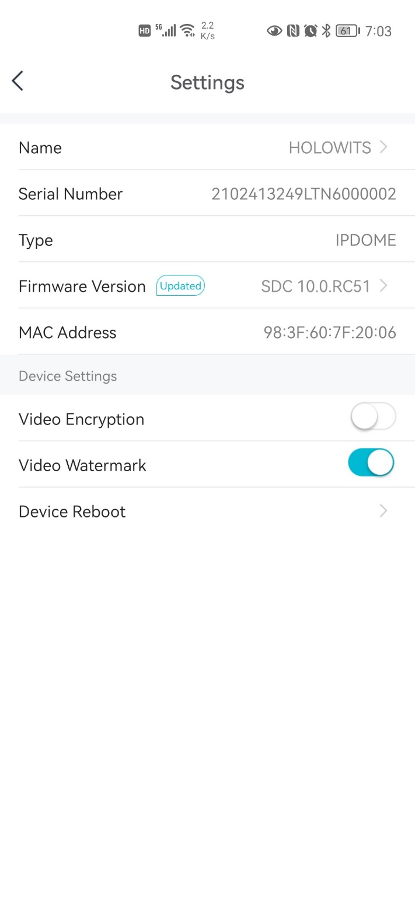
How to Use Basic Functions (4)
View details on the Settings page.
Device name
Device SN
Device type
Firmware version
Device MAC address
Video encryption switch
Video watermark switch
Remote device restart

Slide 13
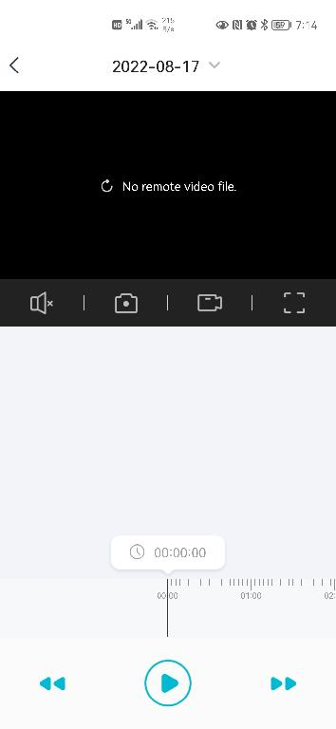
How to Use Basic Functions (5)
Play back recordings.
Calendar for you to select a day on which recordings are to be played back
Recording playback page
Redirection from the live video viewing page to the recording playback page
2x or 4x slow forward
Pause/Play
Progress bar of recording playback
2x or 4x fast forward

Slide 14
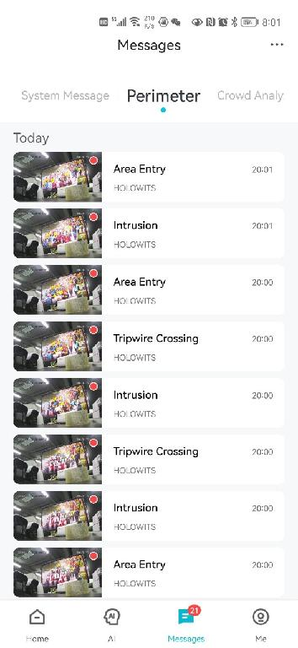
How to Use Basic Functions (6)
View alarms.
You can view alarms generated by cameras on the app.
Different alarm types
Switch to the Messages page on the app.
View details of an alarm message.
Play back recordings triggered by the alarm.
View live video triggered by the alarm.
Alarm messages
Messages page

Slide 15
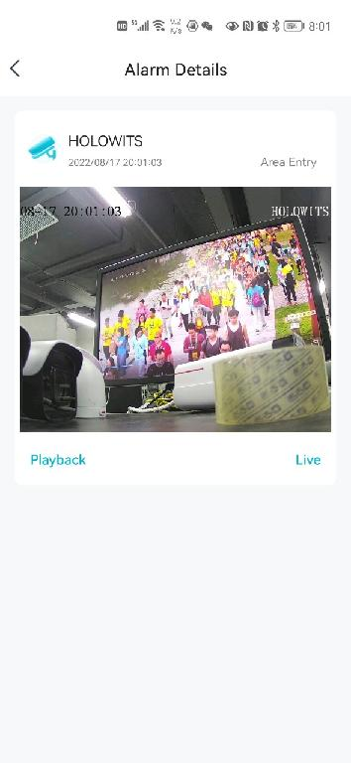
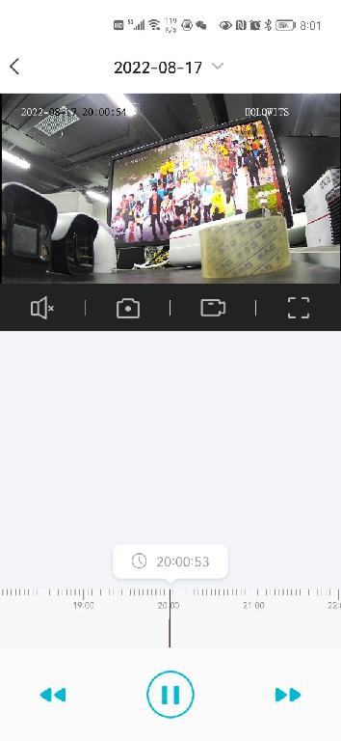
How to Use Basic Functions (7)
View alarms.
You can view alarms generated by cameras on the app.
Switch to the Messages page on the app.
View details of an alarm message.
Play back recordings triggered by the alarm.
View live video triggered by the alarm.
Recording playback (available when the alarm-triggered recording function is enabled in the camera web system)
Live video viewing

Slide 16
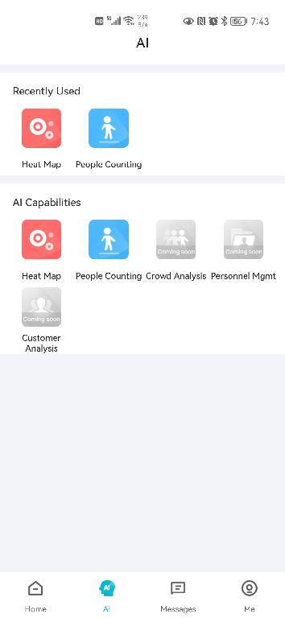
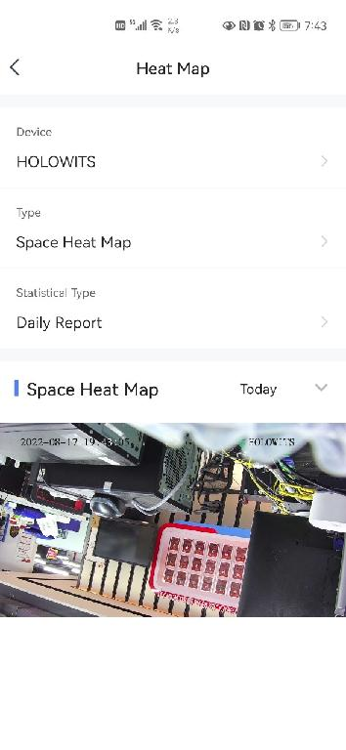
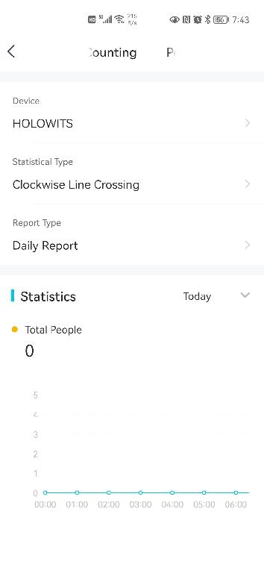
How to Use Basic Functions (8)
Perform heat map and head counting functions.
Switch to the AI page on the app.
Click Heat Map, select a camera, and view the heat map.
Click People Counting, select a camera, and view head counting statistics.

