Slide 1
HUAWEI WiFi AX3 Briefing

Slide 2
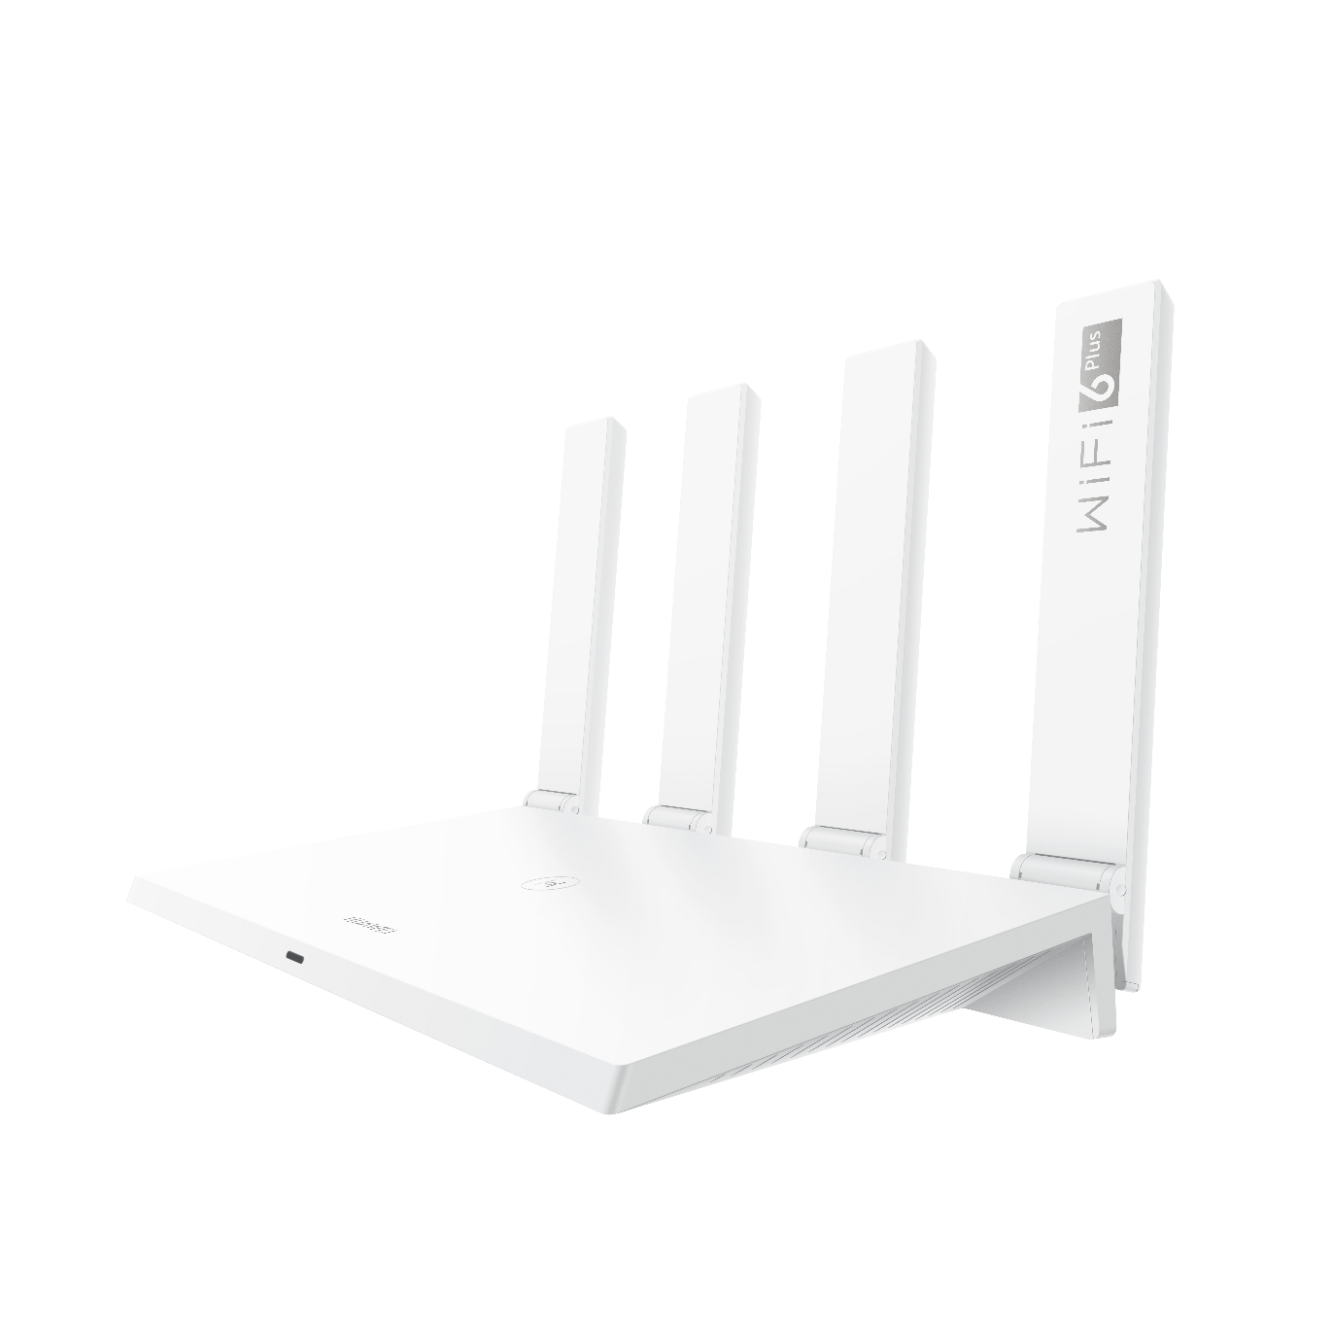
HUAWEI WiFi AX3
Wi-Fi 6 Plus 3000Mbps | Visualized Wi-Fi Diagnosis | Parental Controls
IoT营销部：袁浩文

Slide 3
AX3 Message House
HUAWEI WiFi AX3
Position
Flagship Wi-Fi 6 Router
TA
Midsize family, users who have high-speed and high-quality Internet access requirements, interested in Wi-Fi 6
DNA
Fastest
Simplest
Smartest
Safest
KSP
Wi-Fi 6 Plus
HarmonyOS Mesh+
Easy to Set Up
HUAWEI AI Life
HUAWEI HomeSecTM
Watch 4K films instantly, and stream HD games smoothly
Internet speed would increase 60% and more
Multiple devices connection without disconnected and delay
High-speed and stable networking (One AX3 can cover up to 90 m², Two AX3 cover up to 160 m² )
Stop dropping your Wi-Fi connection, Wi-Fi hotspot switching delay is as low as 50 ms
Easy to set up your home network
Viewing the Wi-Fi coverage situation clearly
Easy to resolve the connection problems
Manage your Wi-Fi with Ease
Easy to manage your kids time online
Keeping the security and privacy for all connected devices in your family
Benefits
Wi-Fi 6 Plus 3000Mbps
5GHz @ 160MHz
Connection up to 128 devices
Easy for multi-router networking
Super Seamless Roaming
Only 3 steps to set up your router
Visualized Wi-Fi Coverage
One-Click Troubleshooting
Wi-Fi Management
Parental Controls
Anti-Brute Force
Anti-ARP spoofing
One-click removal of strangers
WPA3
Feature

Slide 4
TOP 3 Selling Point
Wi-Fi 6 Plus 3000Mbps
3000 Mbps high-speed Wi-Fi, full use of operator bandwidth, and greatly improved Internet access speed.
Visualized Wi-Fi Diagnosis
Providing Wi-Fi coverage map, helping You to Diagnose Network Issues
Parental Controls
Easy to manage your kids time online
Theoretical maximum speed (574 Mbps @2.4 GHz +2402 Mbps @5 GHz). Actual speed may vary depending on conditions of use and devices.

Slide 5
Wi-Fi 6 Plus 3000Mbps
HUAWEI WiFi AX3 is a Wi-Fi 6 Plus product with a rate of 2402 Mbps(5GHz) and 574 Mbps(2.4GHz). It maximizes your cable bandwidth, effectively reduces the delay of online games and High-speed downloads of large files and HD movies.
5GHz-2402 Mbps
2.4GHz-574 Mbps

Slide 6
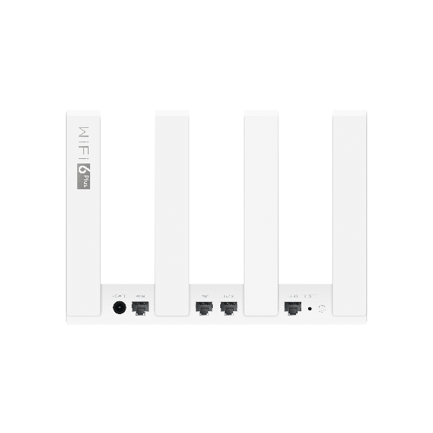
Gigabit WAN/LAN Auto-adaptation
HUAWEI Wi-Fi AX3 also offers four Gigabit Ethernet connection for speeds as fast and consistent as possible，each port supports WAN/LAN auto-adaptation. Users do not need to identify network ports, facilitating broadband installation.

Slide 7
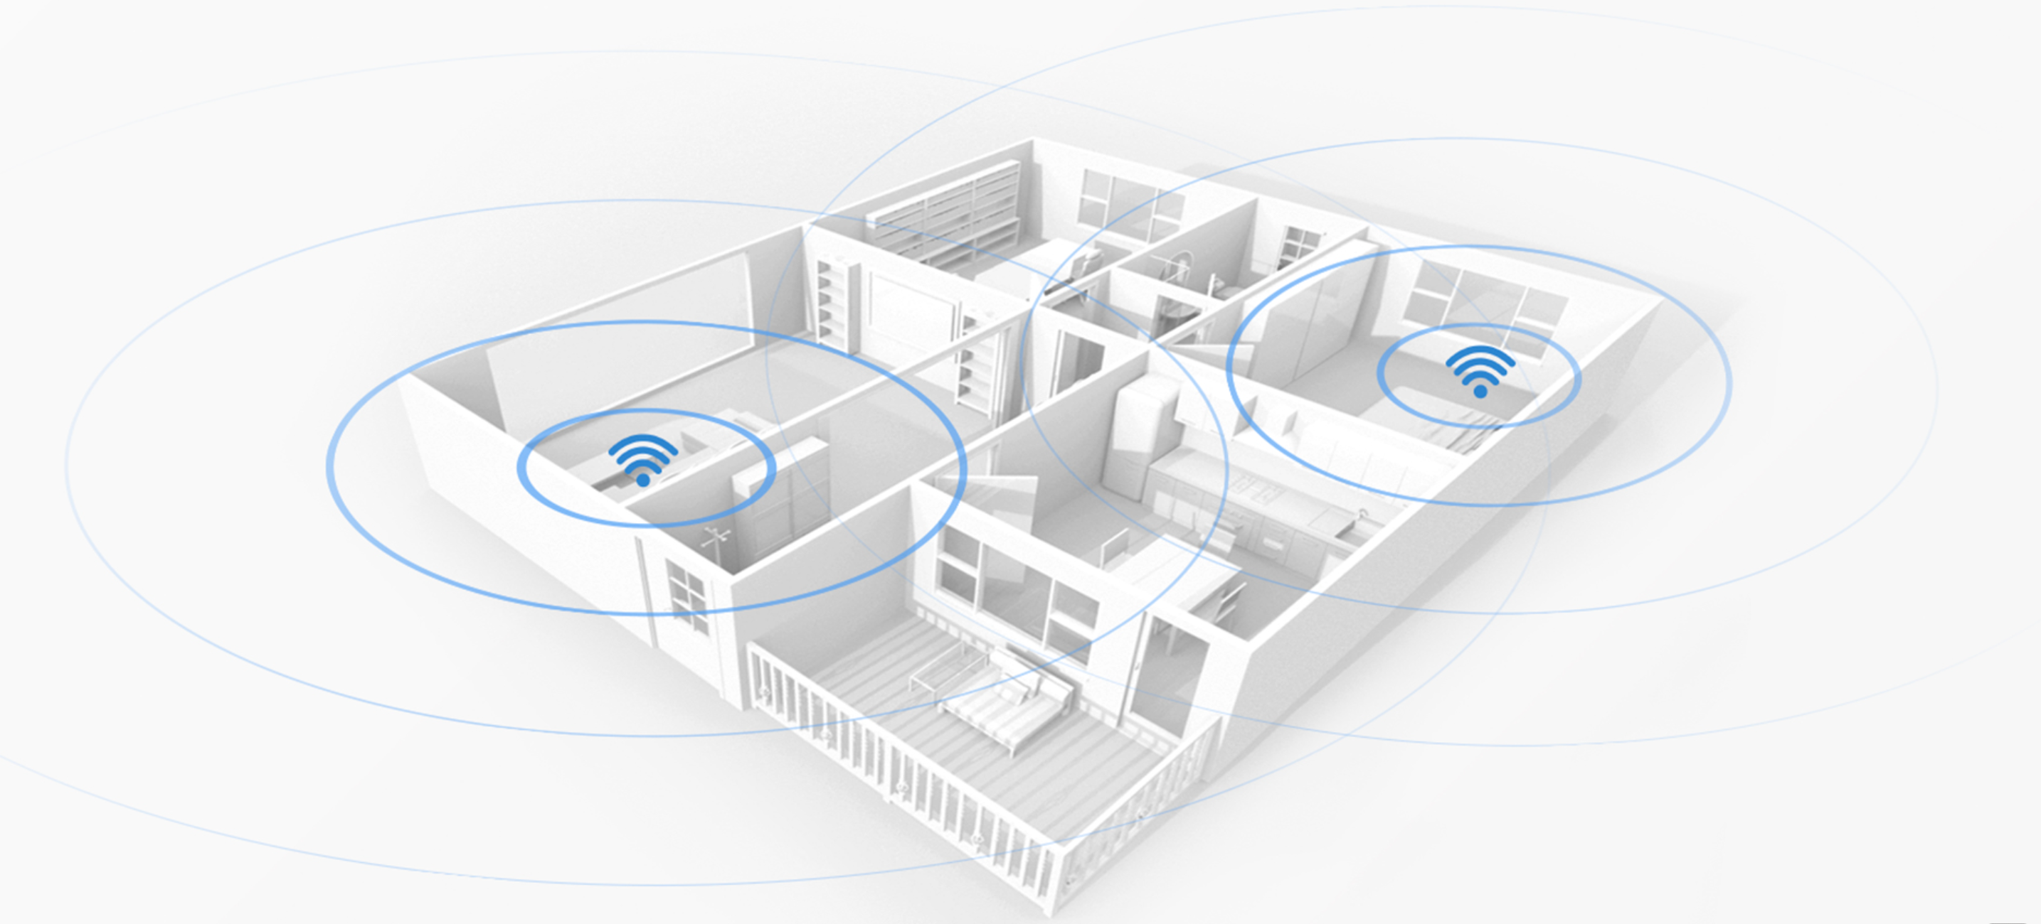
HarmonyOS Mesh+ For broader coverage
AX3 supports wireless networking and cable networking. After networking, multiple routers are automatically grouped under one Wi-Fi name, and the optimal Wi-Fi is automatically selected based on the device's location.
AX3 supports seven kinds of seamless roaming technology, and the Wi-Fi hotspot switching delay is as low as 50 ms, no freezing during house-wide games and online video.

Slide 8
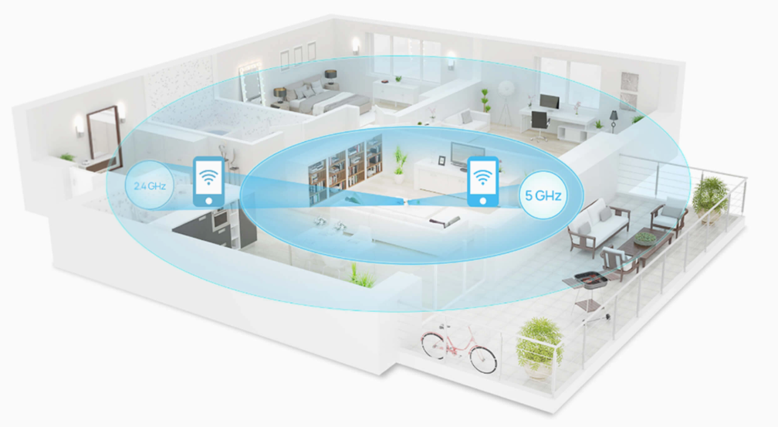
Auto Connect to the Optimal Wi-Fi
HUAWEI WiFi AX3 comes with 5GHz and 2.4GHz bands that operate simultaneously. Your devices will automatically switch between the 5GHz and 2.4GHz bands for optimal use. 5GHz is for fast speed gaming and streaming, while 2.4GHz provides wider coverage.

Slide 9
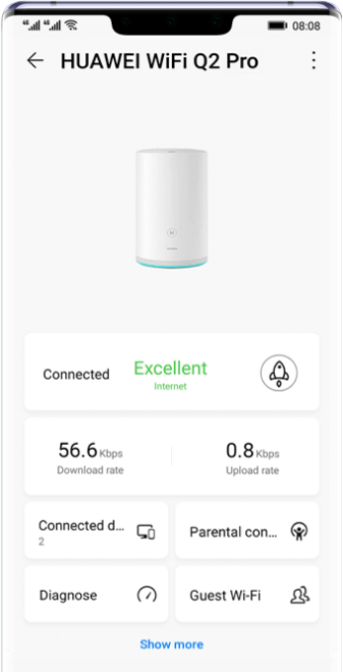
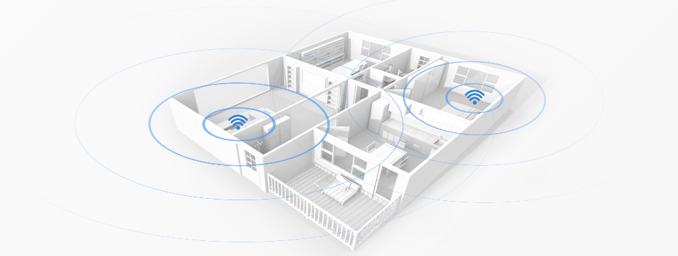
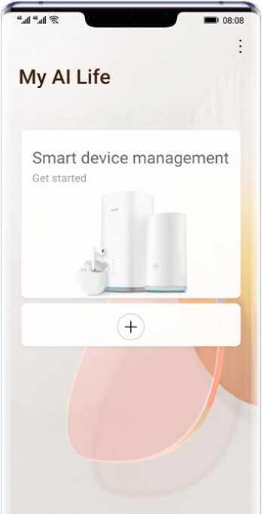
Easy to build, easy to use
One Wi-Fi Network
After networking, routers are automatically grouped and managed under one Wi-Fi name
Seamless Roaming:
The optimal Wi-Fi is automatically selected based on the device's location
APP Management
(802.11v, switching time< 100ms)
SSID: Myhome
SSID: Myhome

Slide 10
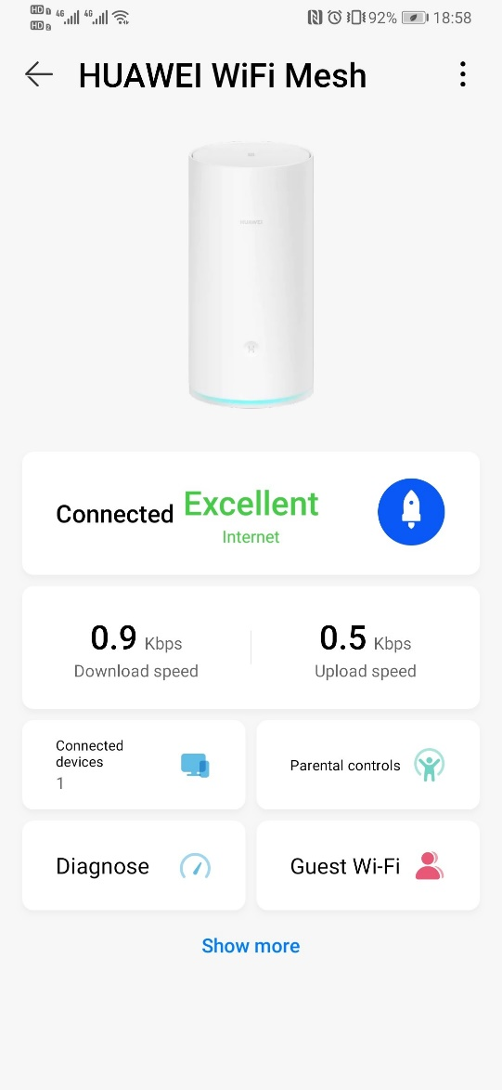
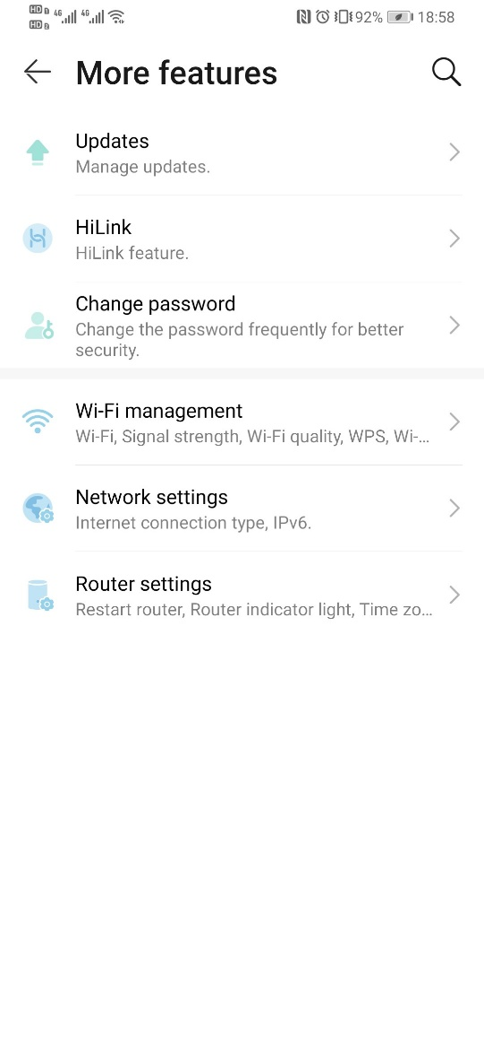
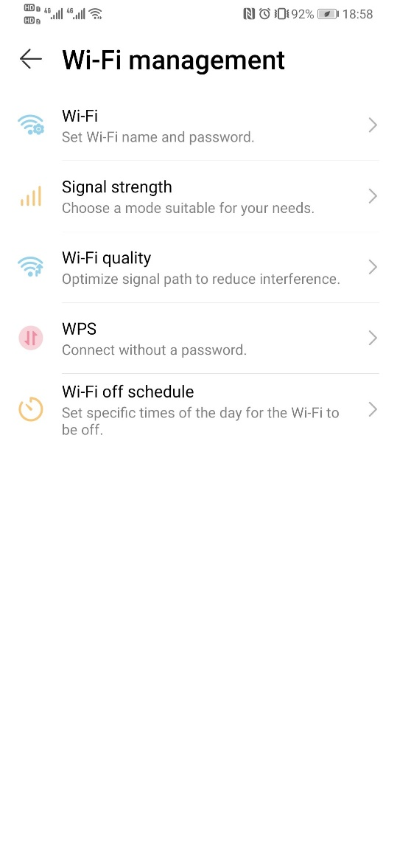
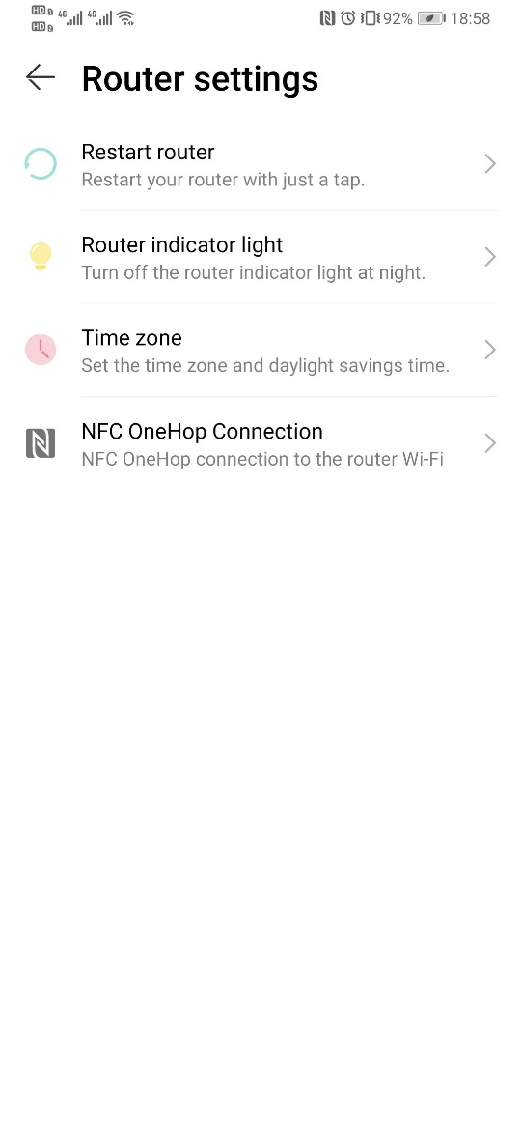
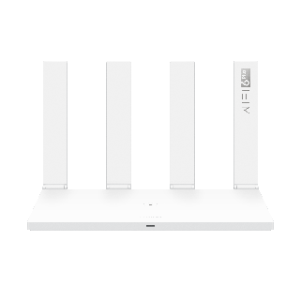
Manage Wi-Fi with Ease
Wi-Fi management has never been easier. With the HUAWEI AI Life App, you can see what happens, set speed limits, allow guest connections, set Wi-Fi timing, pause connectivity on your kids' devices and more.
Notes:
素材太旧了

Slide 11
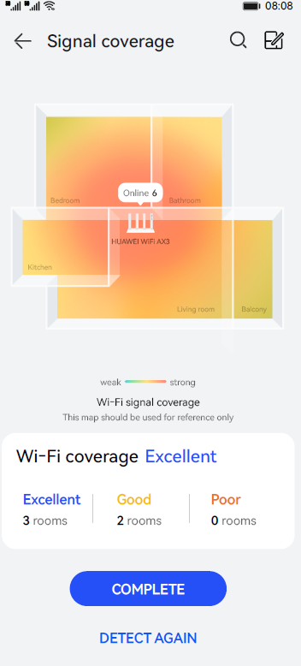
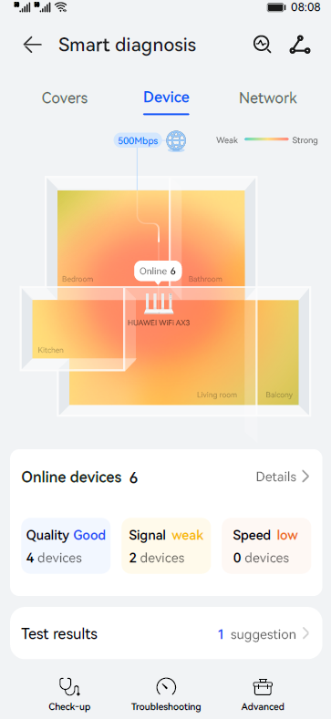
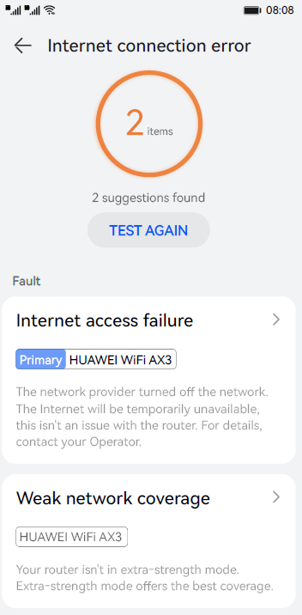
Visualized Wi-Fi Diagnosis
In addition to providing Wi-Fi coverage map, it also can diagnose home network status and help you troubleshoot problems easily. ）
Notes:
1，待提供海外UI

Slide 12
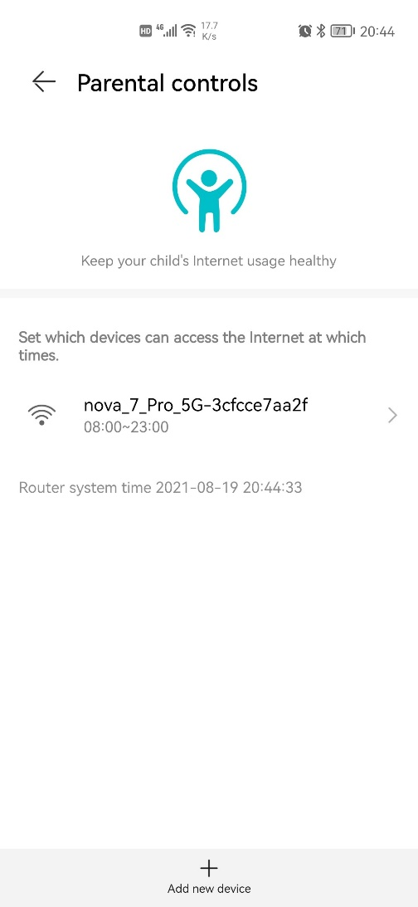
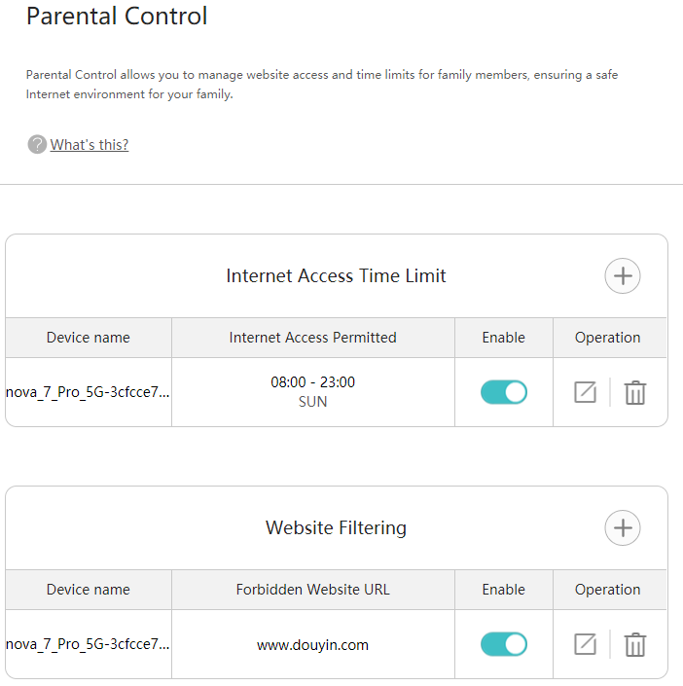
Comprehensive Parental Control
Thanks to parental controls, you can keep track of your family’s online activities even when you’re not at home. With a few taps on your phone, HUAWEI WiFi AX3 can block out inappropriate websites and limit access to selected devices.

Slide 13
HUAWEI HomeSecTM
Protecting you all connected devices the security and privacy for all connected devices in your family
Anti-Brute Force
Anti-ARP spoofing
One-click removal of strangers
WPA3
Notes:
孙云云的特性，显性化：

Slide 14
Unique
More Stable than Ever
Wi-Fi service
Wi-Fi driver
CPU Schedule
DNS Service
DCA(Dynamic channel adjust)
DBA (Dynamic bandwidth adjust)
Airtime fairness and queuing scheduling optimization
CPU resource scheduling, multi-core load balance
DNS Prioritize
OS-Level
Optimization
2 year aging module
Latency、jitter、packet loss supervision system
More Stable than Ever
Optimization from system-level is the right method in solving aging issue.

Slide 15
Strict quality testing , more stable network
Unique
>100000 hours
>20000 times
>80%(Free CPU)
Long time stability test
50 items total run time
Flow pressure test
several items total test time
CPU occupancy test
10 WiFi devices test for 15 days
>43800 hours
>1000 hours
>100000 times
>12 times
Power stability test
up and down for 5000 times
Harsh environment test
Temperature 85℃ & humidity 85%
Reliability test of Flash
Flash continuous read / write test
Hardware reliability test
0.8 meters drop to Marble floor

Slide 16
Thanks
Thanks

