Slide 1
HOLOWITS APP and Cloud services Introduction

Slide 2
APP and Cloud services Main Function
APP and Cloud Service business form
APP and Cloud Service Highlights
The business value of apps and cloud services

Slide 3
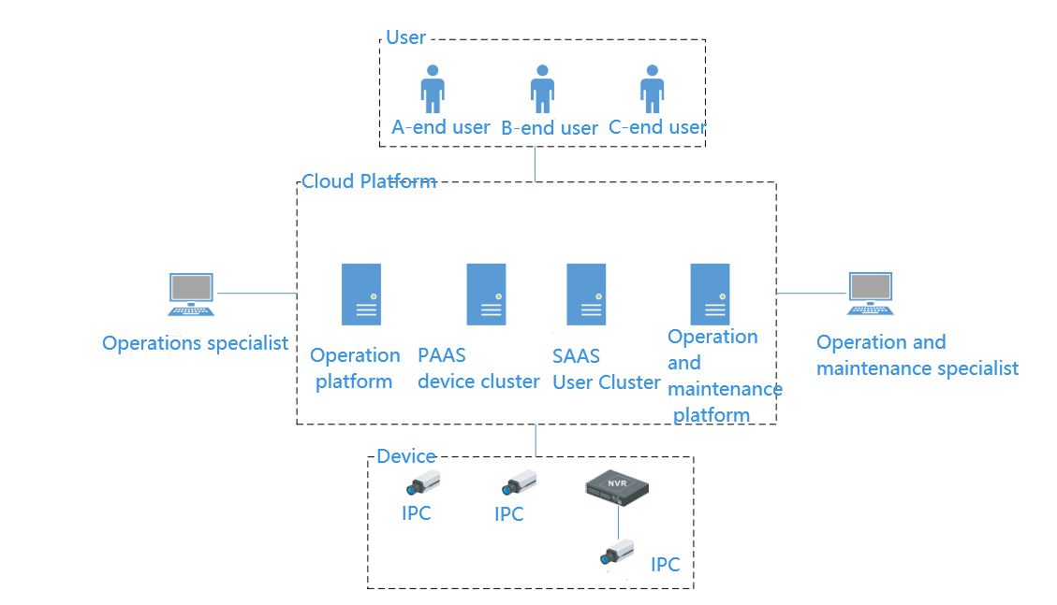
APP and cloud services Main Function
APP adds devices by scanning code
Basic functions: scan code or manually add devices, OSD Setting，video preview, video playback, file management, device sharing management, voice intercom, PTZ control, focus control. etc.
Intelligent functions: passenger flow statistics, heat map.
Alarm message push: AI perimeter, face recognition, face detection, device offline, disk failure and other alarm push.
The cloud platform needs to implement the aggregation and management of perception layer devices, and provide access to the user side, operation side, and operation and maintenance side.

Slide 4
APP and Cloud Service business form
Facing the device side, the cloud platform realizes the functions of active device registration, load balancing, cloud media forwarding, P2P system, alarm message storage, alarm snapshot and video storage.
For the user side, the cloud platform provides iOS and Android client users to enjoy the functions of user registration, device grouping, device sharing, and alarm push provided by the cloud platform.
For the operation side, the cloud platform provides a Web client for service providers to operate and use, and provides operation user management, device model version management, APP version management, data statistics, and feedback functions for global management and operation functions of operation users;
For the operation and maintenance side, the cloud platform provides an operation and maintenance platform to realize host management, service management, environment management, alarm management, Dashboard functions, and realize the deployment and monitoring functions for hosts and services.

Slide 5
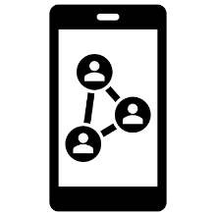
APP and Cloud Service Highlights
P2P Data Penetration
Cloud Media Forwarding
Intelligent Alarm Push
Intelligent Function Interface Display
Operation and maintenance side, operation side, user side, three-terminal management
Unified management of front-end and back-end devices, online upgrade of devices, firmware version viewing and other functions
Accumulation of long-term professional fields
Excellent R&D Testing Team
Standard Development Process
Fast and Efficient Development Cycle
High Quality Delivery
Satisfactory After-sales Service

Slide 6
The business value of apps and cloud services
The APP and cloud services help HOLOWITS to supplement the existing missing platforms and services, and the equipment on the mobile side is managed in a unified manner to help distribute customers with convenient preview images or video playback. At the same time, the device sharing function of the APP can ensure that the unified device can be viewed by multiple users and realize multi-party monitoring.
Enterprise APP can improve the brand height and credibility of enterprises. Now is the era when the mobile Internet is the mainstream, and the mobile APP will gradually become the standard configuration of an enterprise. Just like the construction of a PC website, enterprises also need to establish a corporate image and improve their corporate reputation through the development of mobile APPs.
Collect customer feedback quickly and efficiently. Through the development of mobile APP, instant message interaction can be realized, and the information feedback from customers in the first time can be collected, which is conducive to enterprises to take timely countermeasures and provide timely services.

